Slide 1


SOEN 6011 - Software Engineering Process Group Project : Career Services Application
Developed by : Team Eureka
Guided by : Jimi Mehta (TA)
Submitted to : Prof. Joumana Dargham

Slide 2

Introduction to Team Members
Anurag Agarwal - Scrum Master
Shrey Satish Agrawal - QA Analyst/ Software Developer
Aksharkumar Yogeshkumar Patel - Lead Software Developer
Vidhi Vinodbhai Sagathiya - Product Owner
Sagar Sanghani - Software Architect
Karnik Shah - Design Analyst/ Software Developer

Slide 3

Contents
Project Objective & Scope
Project Approach
Architecture and Design
Overview of Sprint tasks
Testing Plan
Challenges Faced & Lessons Learned
Future Enhancements

Slide 4


Project Objective
The Career Services Application is an advanced online platform designed to offer a comprehensive career services experience for job-seeking candidates and employers alike.
The system significantly enhances the job-seeking experience by empowering candidates to customize their profiles according to market demands, while enabling employers to easily shortlist potential employees based on their specific requirements.

Slide 5

Project Scope
Core Features
Feature 1: Employer Profile Management
Feature 2: Student/Candidate Profile Management
Feature 3: Tracking
Feature 4: Admin Dashboard
Boundaries and Highlights:
The project focuses on creating a web-based platform to facilitate the interaction between employers and students for job matching. The platform allows employers to post job offers, search for candidates, and manage the hiring process. Students can create profiles, upload resumes, browse job offers, and track their applications. The admin dashboard empowers the admin to oversee users, job postings, and applications.
The project does not extend to handling financial transactions, complex AI algorithms, or extensive communication features. While it facilitates tracking of job postings and applications, it doesn't delve into deep reporting or analytics. Additionally, integrations with external systems and mobile app development are not within the project's scope.

Slide 6
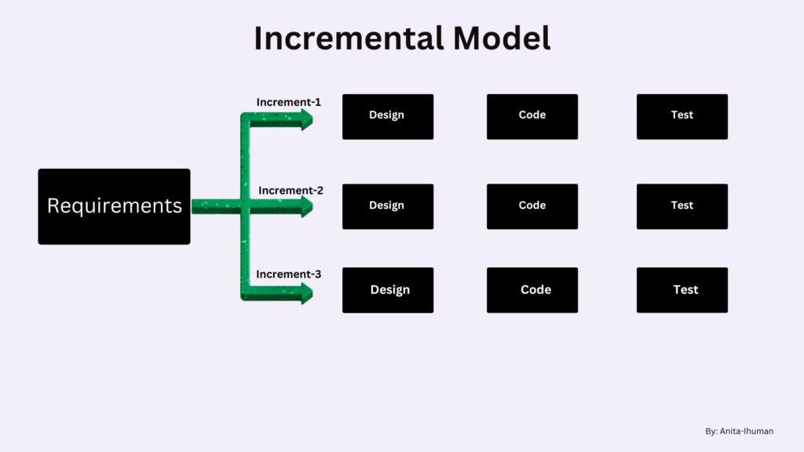
Project Approach
Our project, Web-Application for Career Service employs an adaptable approach to software development and will use agile methodology to manage all project operations.
We have developed our features in 4 iterations using incremental model.
Each iteration passes through the requirement analysis, design, coding and testing phase.

Slide 7


Technologies Used:
Architecture and Design:
The Career Services web Application follows a modular and layered architecture. The architecture is primarily based on the Model-View-Controller (MVC) design.
The core architecture follows the MVC pattern, which separates the application into three main components: Model, View, and Controller.
The interactions between frontend and backend components are facilitated through a APIs. This allows for decoupling and ease of communication between different parts of the system.
Overall, this architecture ensures modularity, scalability, and separation of concerns, allowing for efficient development, maintenance, and expansion of the System.
Database | MongoDB
Frontend | ReactJS/ JavaScript , HTML, CSS
Backend | NodeJS

Slide 8
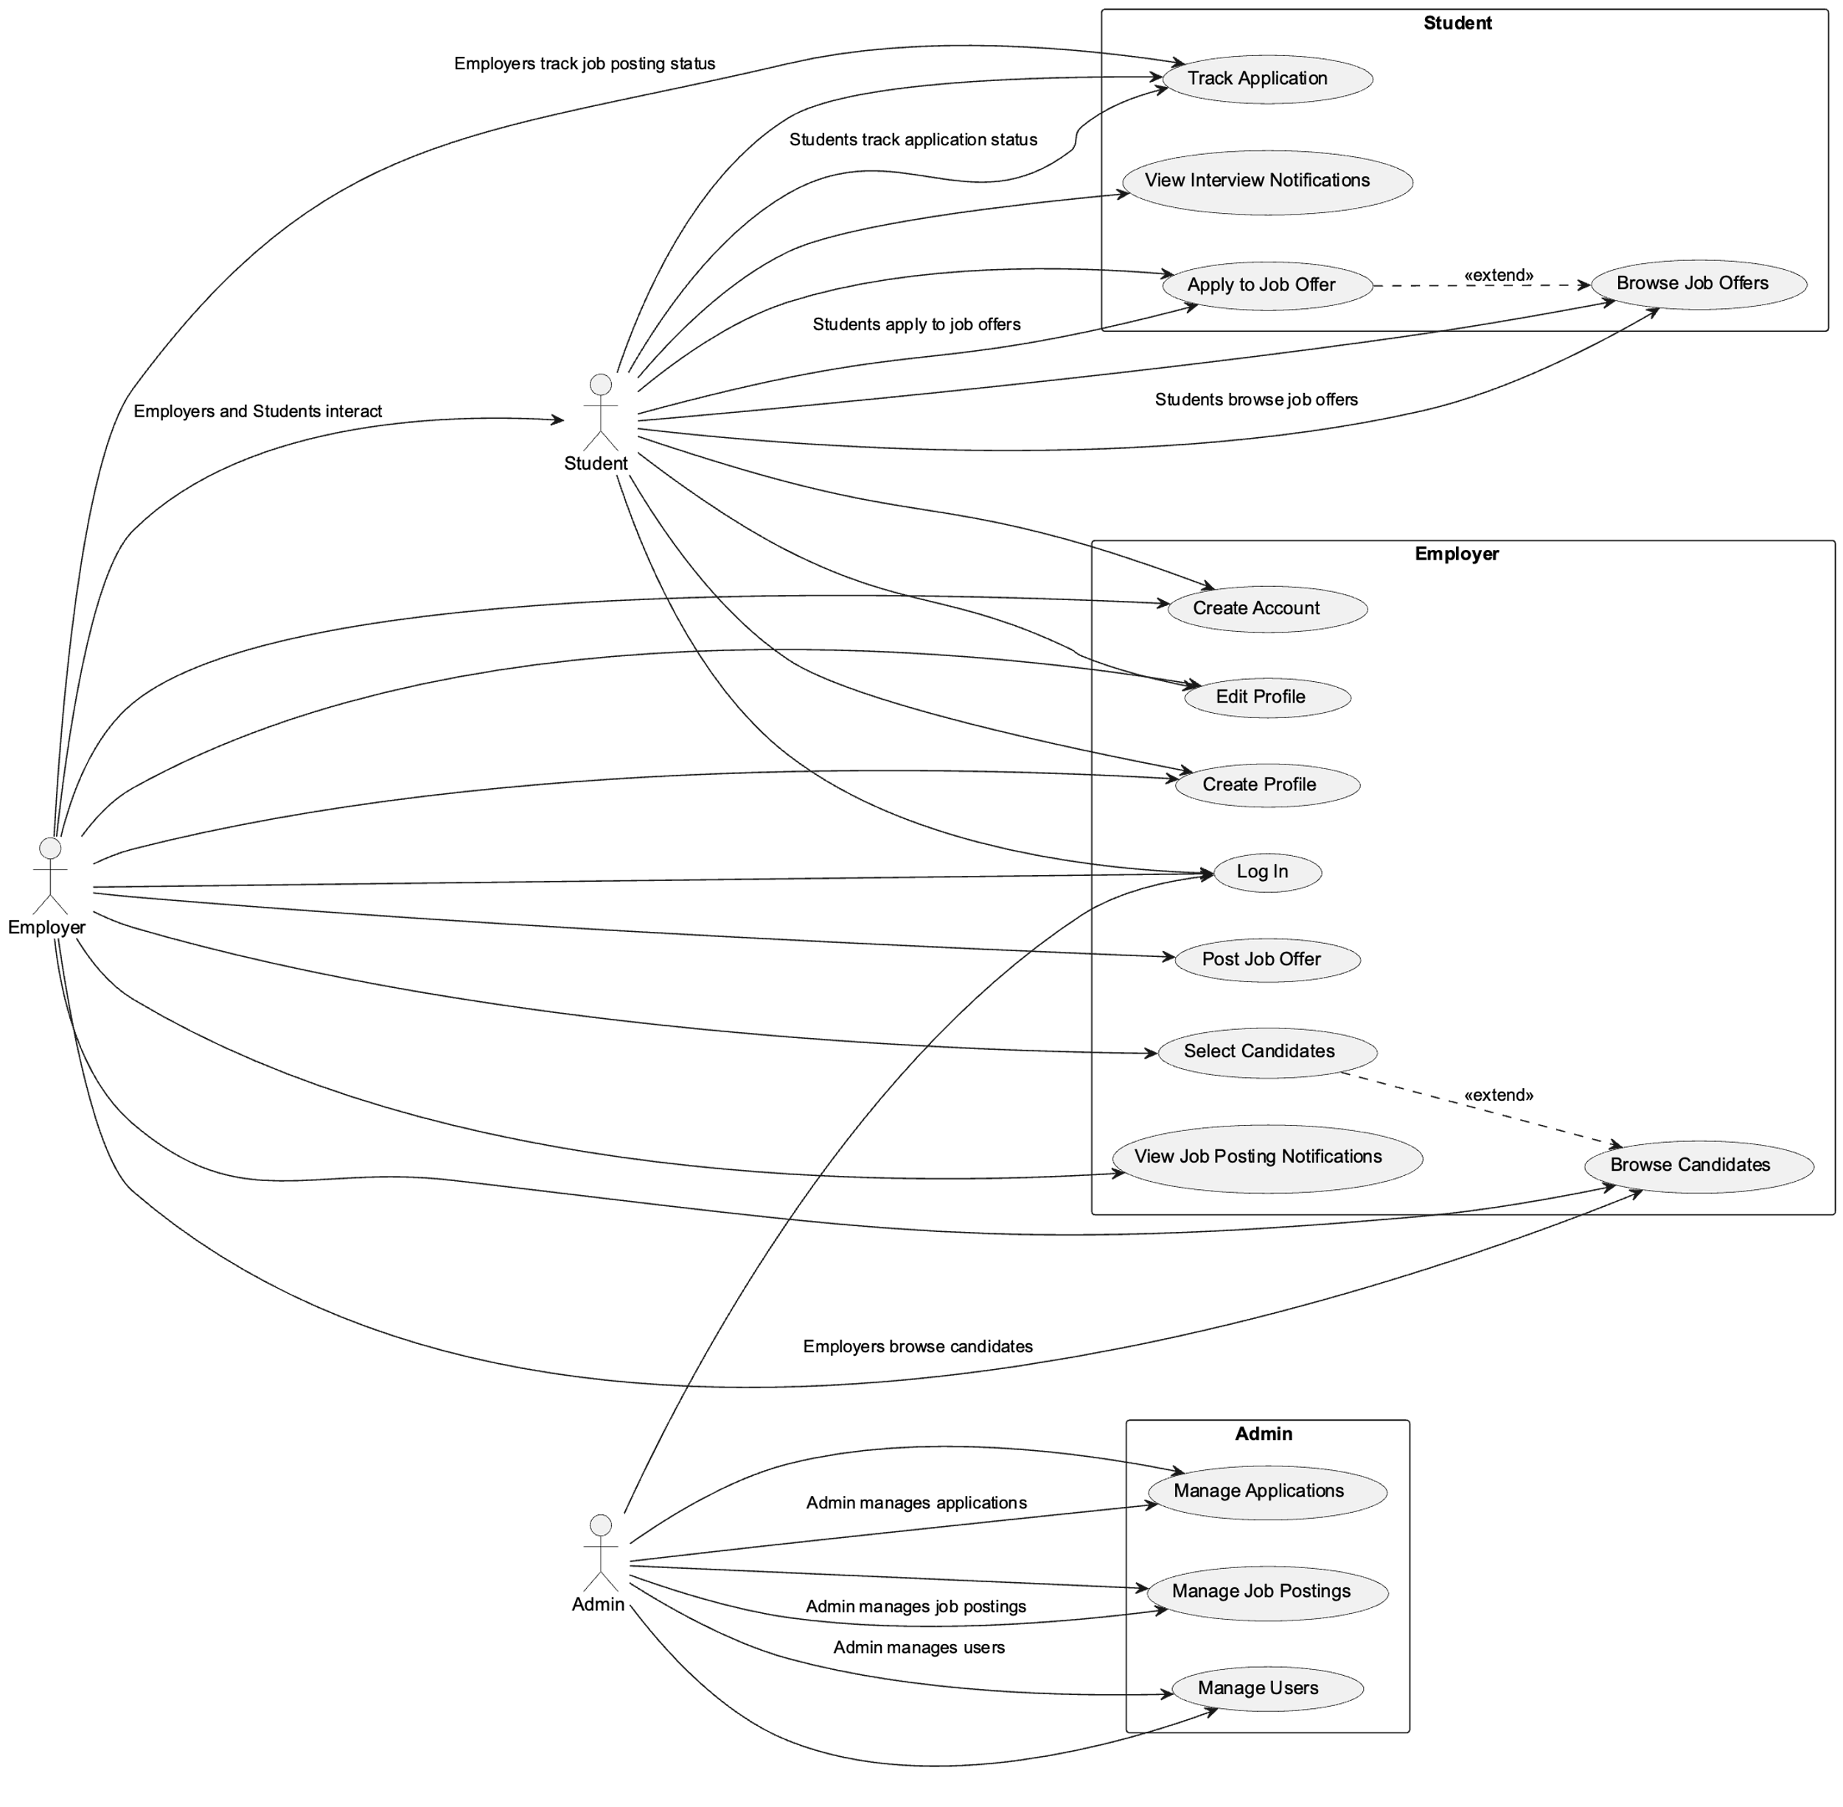
UML DIAGRAM - USECASE

Slide 9
Overview of Sprint tasks
User Story of Sprint-1
Discussion for use of appropriate technology
Discuss the flow of the System
Design and implement of Home Page
User Story of Sprint-2
Create profile for employer.
Add job offers with detailed description.
Browse through candidate profile to select best candidate.
User Story of Sprint-3
Select best candidate for a particular job
As a student create profile and apply for a job
Track status of applied job
Upload/Build resume
View/Download resume of candidate from employer’s side
Admin Panel
User Story of Sprint-4
Open issues of Sprint 3
Performed UAT Testing
Completed CI/CD testing Pipeline testing

Slide 10
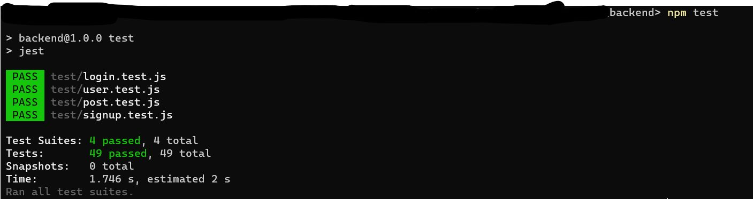
Testing PlaN
Test Automation and Continuous Integration - Github Actions
Utilized automated test suites to run regression tests for frequent code changes. Integrated testing into CI/CD pipelines for quick feedback and efficient bug detection
Notes:
GitHub Actions is a powerful tool for automating various workflows in your software development process, including testing. It allows you to define custom workflows as code, and these workflows can be triggered by events such as code pushes, pull requests, or scheduled intervals

Slide 11
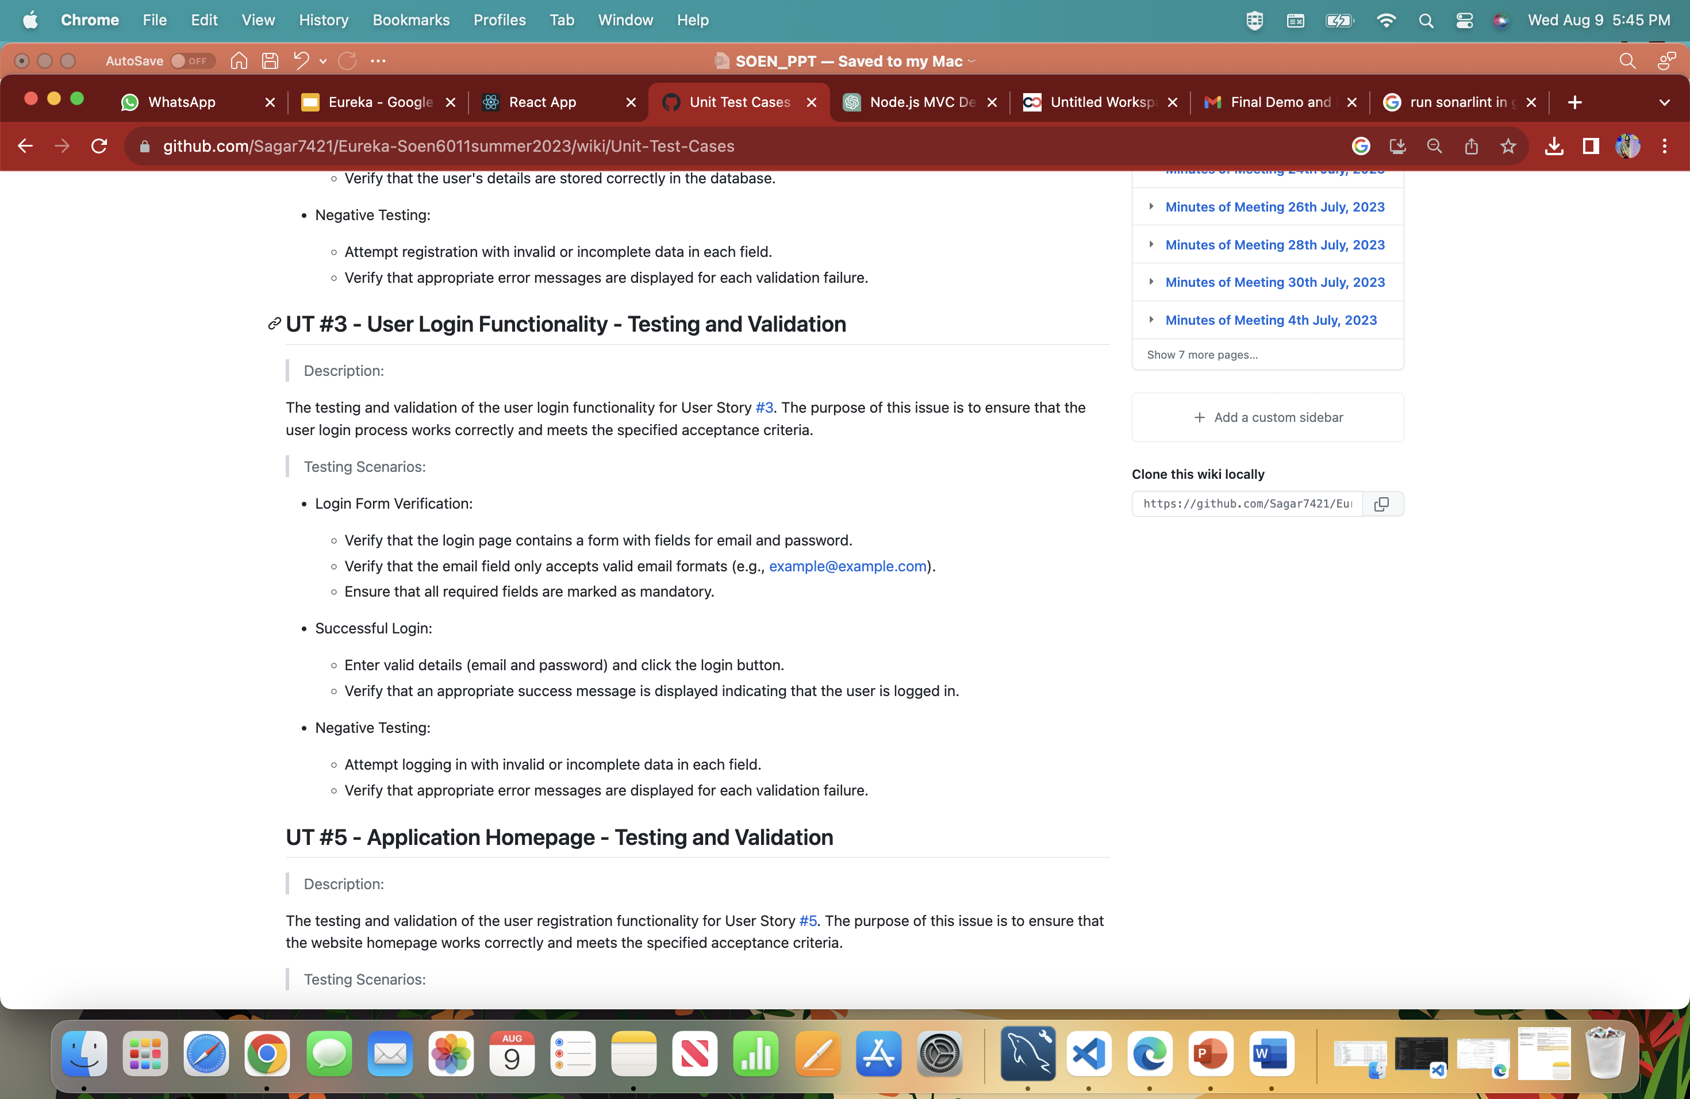
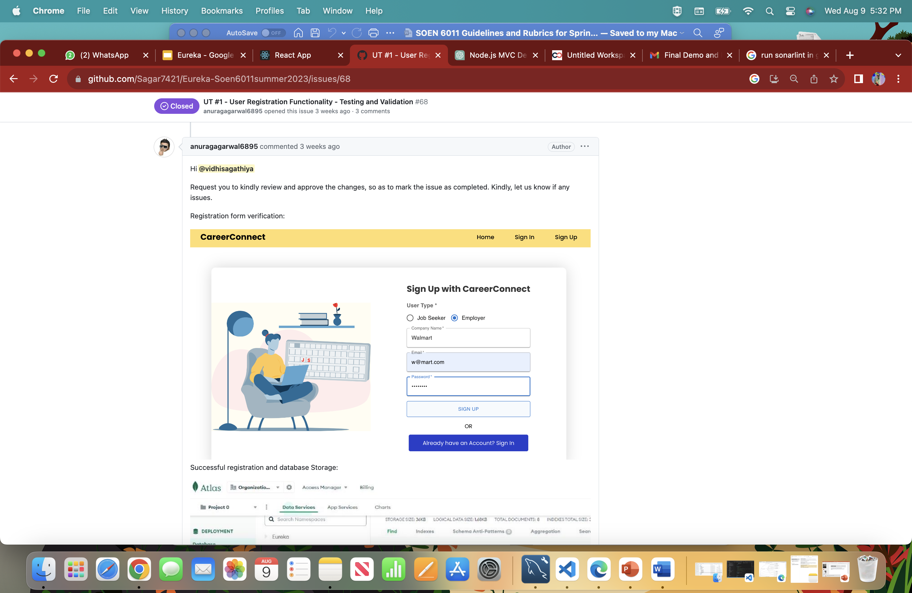
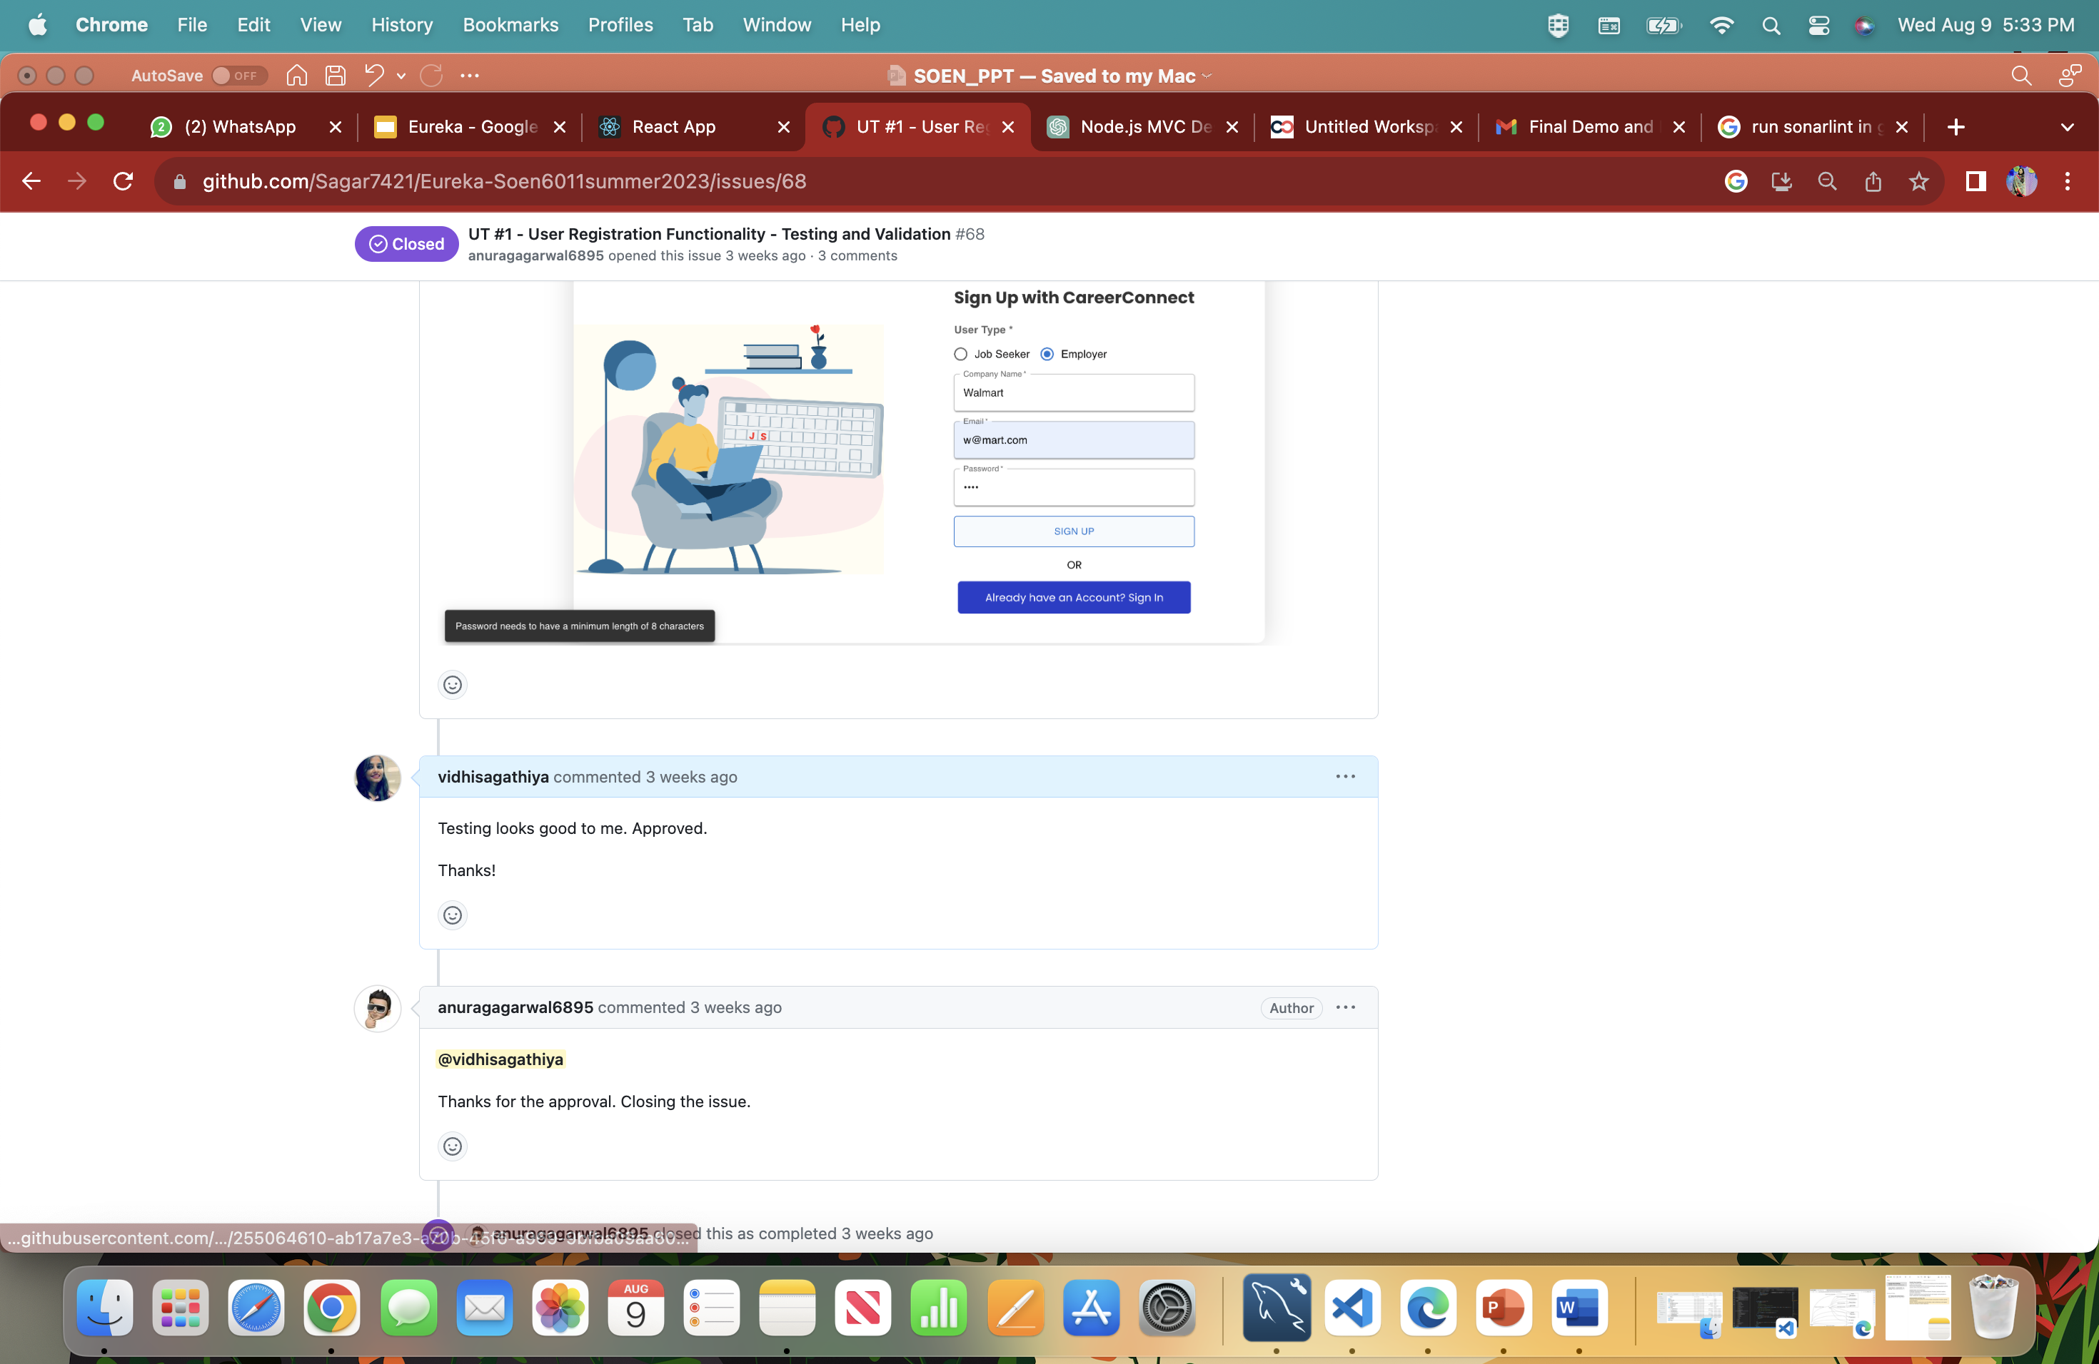
Unit Testing
Unit tests focus on testing individual components and functions in isolation. For this project, we wrote unit tests for:
1. Employer Profile Management Tests
2. Student/Candidate Profile Management Tests
3. Tracking Tests
4. Admin Dashboard Tests
Integration Testing
Performed end-to-end tests that simulate typical user flows.
User Acceptance Testing (UAT). Collaborated with end-users to execute UAT scenarios and collect feedback.

Slide 12
Challenges Faced
Flexible Data Modeling
Challenge: Designing data models accommodating evolving requirements for profiles and job postings.
Solution: Employed schema versioning techniques, allowing gradual schema updates without disrupting existing data.
Collaboration Across Domains
Challenge: Developers from different domains (frontend, backend) needing seamless collaboration.
Solution: Implemented cross-functional teams and regular communication to foster collaboration and knowledge sharing.
Communication and Sync-Up
Challenge: Maintaining effective communication among team members spread across locations.
Solution: Utilized collaboration tools like Slack, video conferences, and regular stand-up meetings for better alignment.

Slide 13
Lessons Learned:
Collaboration between frontend and backend teams is vital for a seamless user experience.
Embracing diverse skill sets enriches problem-solving and innovation.
Effective communication is paramount for remote and distributed teams.
Agile methodologies enhance adaptability to changing project requirements.

Slide 14

Future Enhancements:
Secure User Account Management
The suggested feature name, "Secure Account Management," encompasses both the registration confirmation email and the password recovery functionality.
Application Deadline Reminders
Introduce application deadline reminders for students who have applied for job postings. Once a student applies for a job, the system will send them reminders, helping them stay organized and ensuring they don't miss any opportunities.

Slide 15

Thank you
Team Eureka

